Slide 1

Chapter 3
Verification and Validation
Objectives
V diagram provides the basis for every type of software testing.
What are various verification activities?
What are various validation activities?
How to perform verification at each stage of SDLC?
What are various validation test plans?

Slide 2
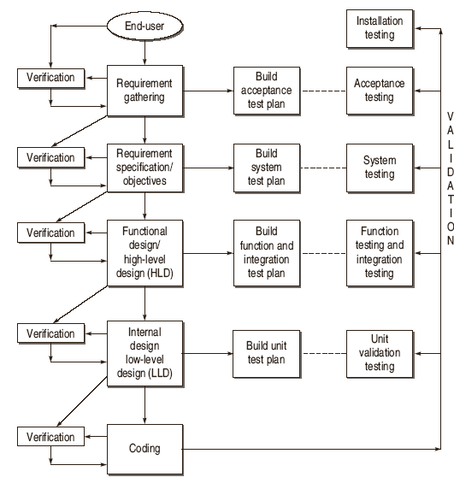
Verification and Validation (V & V) Activities

Slide 3
Evolution of Software Testing
Verification of Requirements
Correctness
Unambiguous
Consistent
Completeness
Updation
Traceability
  Backward Traceability
  Forward Traceability.

Slide 4
Verification of High Level Design
Verification of Data Design
Check whether sizes of data structure have been estimated appropriately.
Check the provisions of overflow in a data structure.
Check the consistency of data formats with the requirements.
Check whether data usage is consistent with its declaration.
Check the relationships among data objects in data dictionary.
Check the consistency of databases and data warehouses with requirements in SRS.

Slide 5
Verification of High Level Design
Verification of Architectural Design
Check that every functional requirement in SRS has been take care in this design.
Check whether all exceptions handling conditions have been taken care.
Verify the process of transform mapping and transaction mapping used for transition from the requirement model to architectural design.
check the functionality of each module according to the requirements specified.
Check the inter-dependence and interface between the modules.
Coupling and Module Cohesion.

Slide 6
Verification of High Level Design
Verification of User-Interface Design
Check all the interfaces between modules according to architecture design.
Check all the interfaces between software and other non-human producer and consumer of information.
Check all the interfaces between human and computer.
Check all the above interfaces for their consistency.

Slide 7
Verification of High Level Design
Check that the response time for all the interfaces are within required ranges.
Help Facility
error messages and warnings

Slide 8
Software Testing Myths
Verify Low Level Design
Verify the SRS of each module.
Verify the SDD of each module.
In LLD, data structures, interfaces and algorithms are represented by design notations; so verify the consistency of every item with their design notations.

Slide 9
How to Verify Code
Check that every design specification in HLD and LLD has been coded using traceability matrix.
Examine the code against a language specification checklist.
Verify every statement, control structure, loop, and logic
Misunderstood or incorrect Arithmetic precedence
Mixed mode operations
Incorrect initialization
Precision Inaccuracy
Incorrect symbolic representation of an expression
Different data types
Improper or nonexistent loop termination
Failure to exit

Slide 10
Validation
Developing tests that will determine whether the product satisfies the users’ requirements, as stated in the requirement specification.
Developing tests that will determine whether the product’s actual behavior matches the desired behavior, as described in the functional design specification.
The bugs, which are still existing in the software after coding need to be uncovered.
last chance to discover the bugs otherwise these bugs will move to the final product released to the customer.
Validation enhances the quality of software.

Slide 11
Validation Activities
Validation Test Plan
Acceptance Test Plan
System Test Plan
Function Test Plan
Integration Test Plan
Unit Test Plan
Validation Test Execution
Unit Validation Testing
Integration Testing
Function Testing
System Testing
Acceptance Testing
Installation Testing

